Slide 1
An Exploratory Data Analysis of Macau’s 3rd city-wide Nucleic Acid Testing

Slide 2
Table of Contents
Background
Data Sources
Data Prep
Data Wrangling
Preliminary Analysis
Summary
Reference

Slide 3
Background
Under COVID-19 pandemic in 2021, when new imported cases is reported, Macau SAR will launch one round of city-wide nucleic tests to prevent the corona-virus from spreading to local communities. This is an exploratory data analysis of Macau’s 3rd time city-wide NAT over the period of October 4th 9pm - 7th 9pm. This time Macau Government and the Health Bureau has shorten the overall period, targeting to complete process for over 600k citizens within 48 hours. (There were 8 locations kept swab station working as usual for continuing after the first 48 hour)
The questions we seek here are: - What time is the most busy time during day? - If any location is over stressed or too free? - If overall performance is well balanced among each location?

Slide 4
Data Sources
City-wide Nucleic Acid Test Booking Stats As the sources claims the “Number of booking will only be counted when it is valid”, therefore the number is treated as the fact number of swab done in our analysis. A backup of the data source is available upon requirement: [https://github.com/adamzerg/SSM-RNA-Test/blob/main/RNA010/20211004.7z]

Slide 5
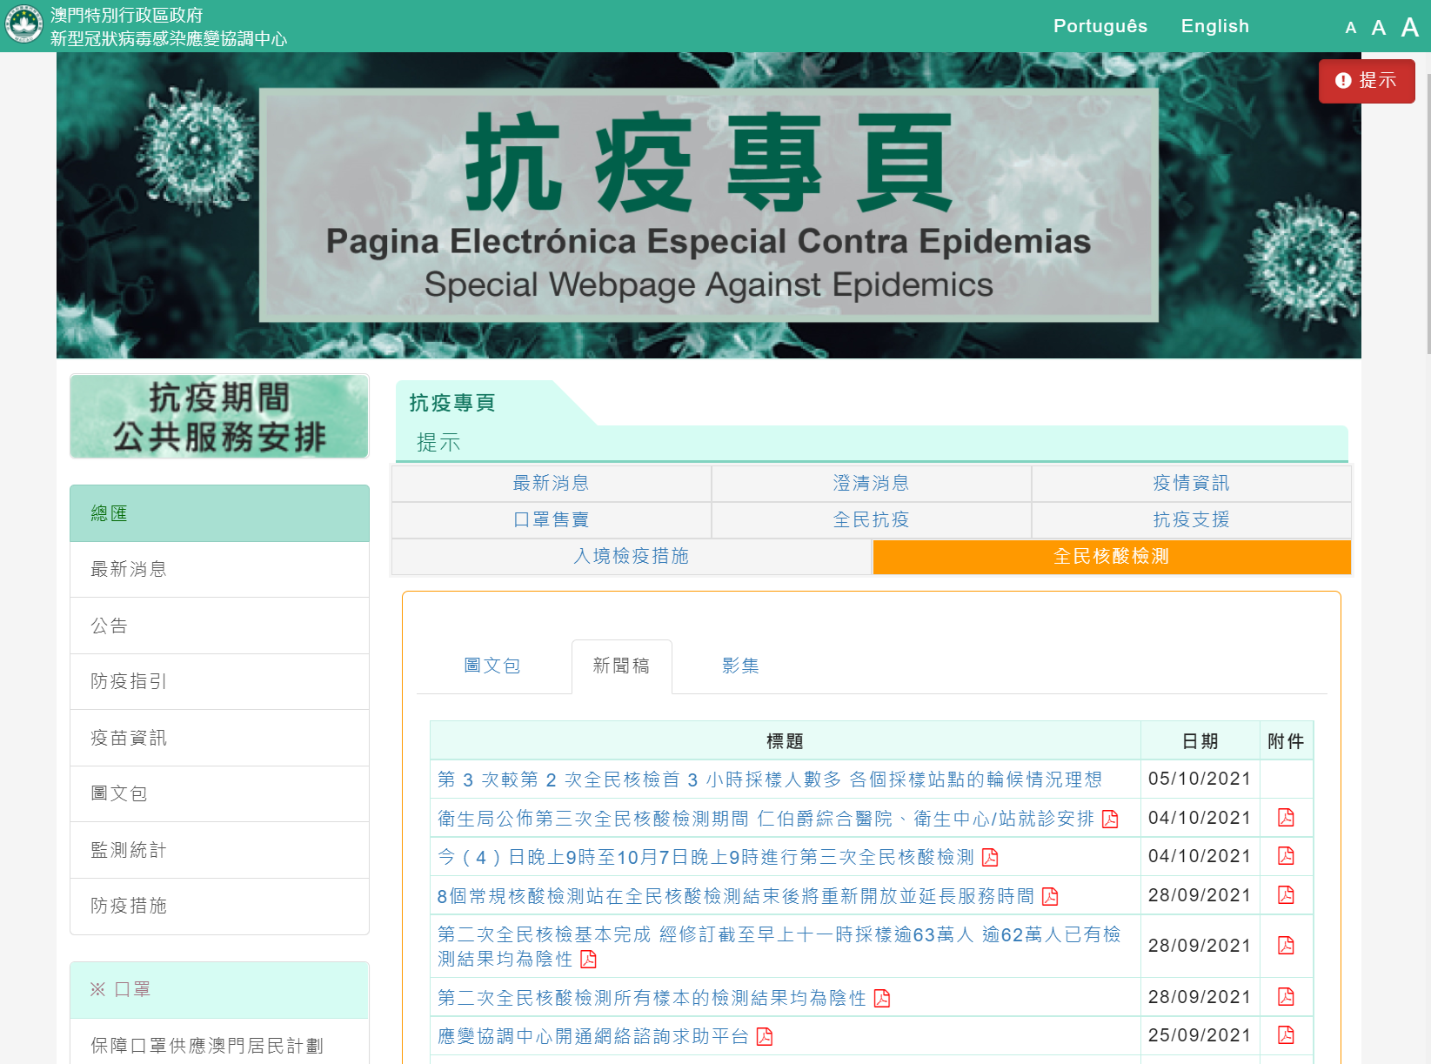
PreventCovid-image-tag

Slide 6
Special webpage against Epidemics - Near real-time waiting stats at each swab station location The source is refreshed about every 10 minutes, source including number of swab stations by nasal / mouth, locations by category, waiting time. A backup of the data source is available upon requirement: [https://github.com/adamzerg/SSM-RNA-Test/blob/main/aptmon-scraping/20211004.7z]

Slide 7
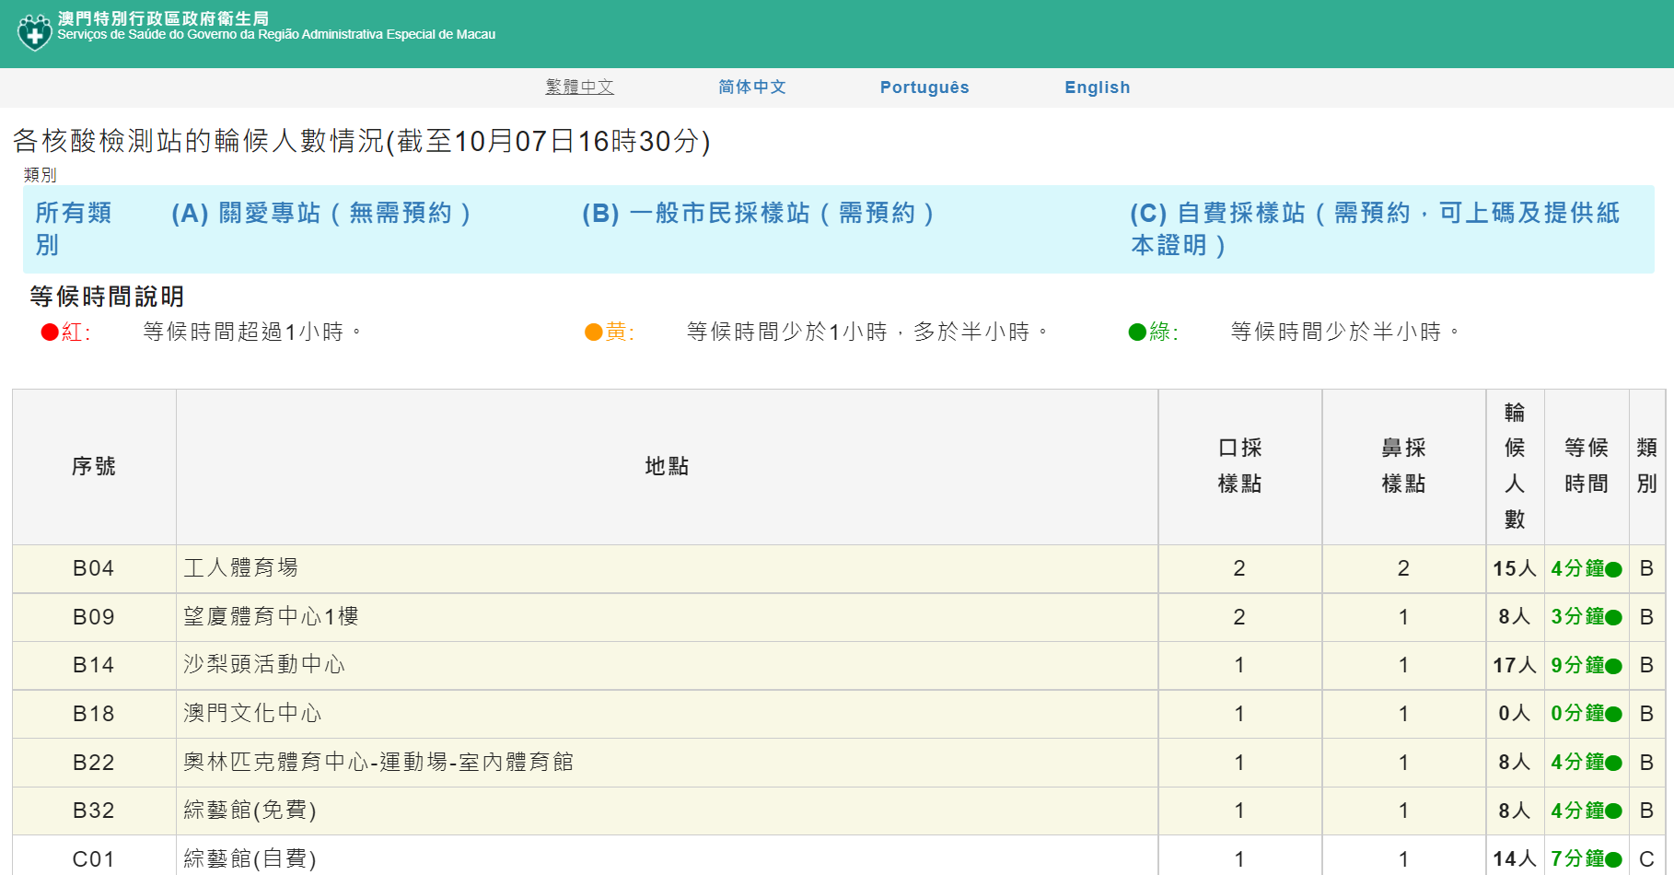
Station-image-tag

Slide 8
Expected Formula Load balance at one location = Source 1：Number of Swab per 30 minutes / Source 2: (Nasal Swab Desks + Mouth Swab Desks)

Slide 9
Data Prep
Source 1 is Excel, preparation including
Select the latest record only
Set a loop to extract information from the specific 4 spreadsheets
Pivot for nasal / mouth swab counts based on granularity time (every 30 minutes)

Slide 10
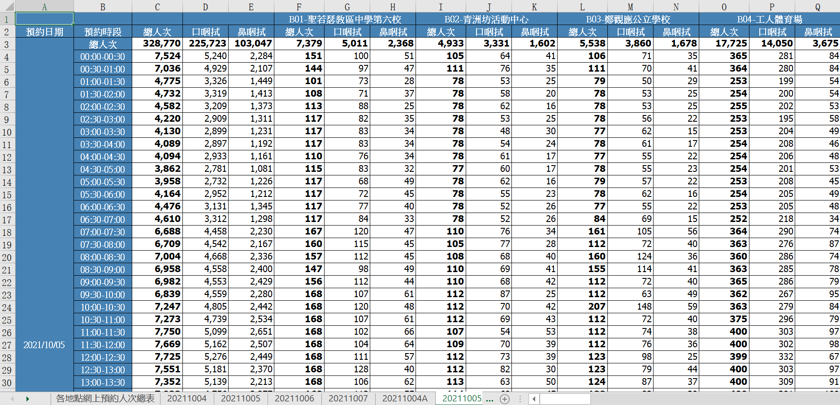
RNA010-image-tag

Slide 11
Source 2 is web scraped by setting schedule, preparation including
Batch load in once for all scraped histories
Add for time format for convenience

Slide 12
Data Wrangling
Since Source 2 are scraped from near real time, need to:
Deduplicate for 30 minutes duration, and determine count / measures with their median value
Backfill 3 missing timeframe at Oct-05 6am / 8:30 am / 9am
Extract geolocation information
Merge two sources into one, only category B remains after merged

Slide 13
Preliminary Analysis
Fact Ratios
Total bookings is 627,865 from source 1, i.e. Category B (General Station) only
The mouth swab total is about 2.3 times than nasal swab
Total swab in Macau peninsula is about 2.8 times than Taipa plus Coloane

Slide 14
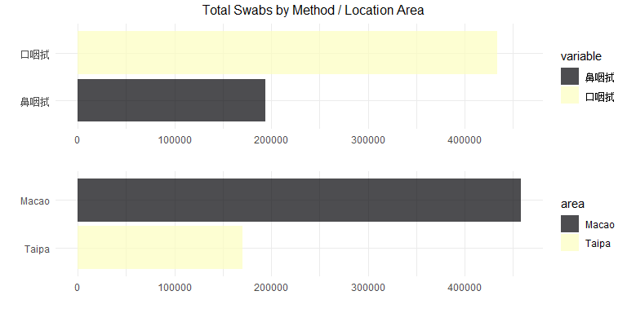

Slide 15
When time is the most busiest time in a day?
Set quartile value based on number of swab per station
The 1st tile has most count overnight, and the 2nd and 3rd mostly appears by daytime
Note for the 4th tile, 3 peaks goes to 7am / 1pm / 8pm, each appears for more than 45 times
The 3 peak times matched to people’s peak working hour during a day
Should consider to increase number of stations / swab desks for the specific time frame

Slide 16
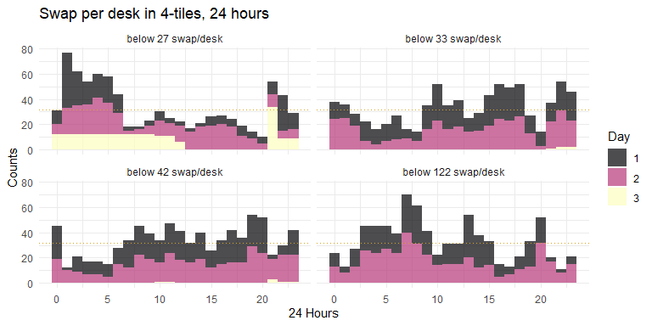

Slide 17
Location stats
From total bookings top 5, there are Venetian Cotai Arena, Workers Stadium, Keang Peng Middle School, Kiang Wu Hospital Auditorium, Macao Cultural Centre
The distribution appears mostly tend to day 1

Slide 18
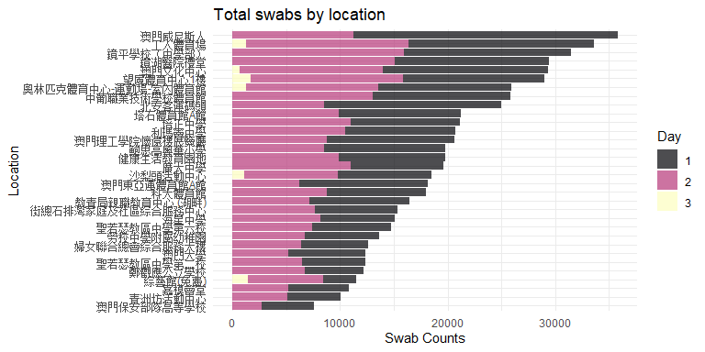

Slide 19
Number of swab desks varies
Outlier can be seen for Worker Stadium, once increased from 10 to 23
The adjustment down at Keang Peng Middle School, Kiang Wu Hospital Auditorium

Slide 20
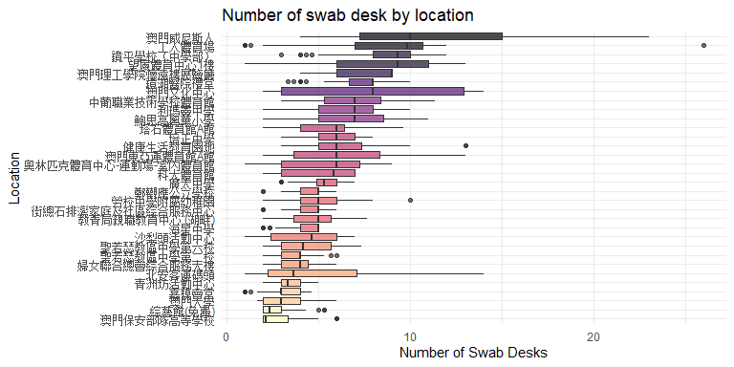

Slide 21
Station load balance
Sort heatmap on the 5th tile swab count proportion by number of desks
The 5tile is set against each location, to number of desks
Why for taipa most swab were done at the 5th tile? e.g. Pac On Ferry Terminal, Venetian Cotai Arena, East Asian Games Dome

Slide 22
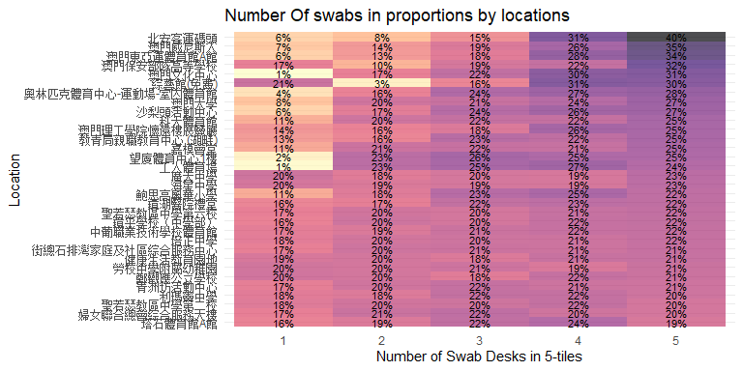

Slide 23
Preview set of 4 stations in Macau over the complete 48 hour (some runs over 48 hr)
At Mong-Ha Sports Centre, Keang Peng Middle School, Worker Stadium, no matter which swab method there are increase and decrease adjustment in swab desk along with swab counts
Macau Forum however has fluctuated swab counts, but rarely has any adjustment in swab desks

Slide 24
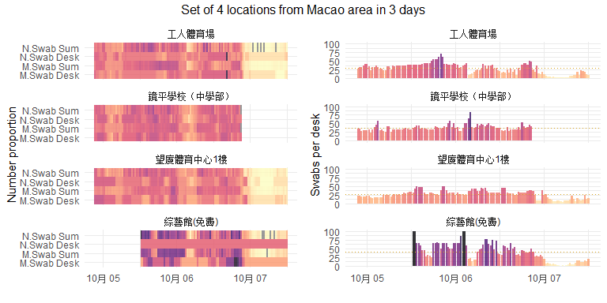

Slide 25
Preview set of 4 stations in Taipa over the complete 48 hour (some runs over 48 hr)
There are darker and lighter intervals one after each in number of swab desks vs swab done, means they were not in a consist ratio
Some spikes appears for Venetian Cotai Arena and East Asian Games Dome but in different time frame, could consider supporting each other in due time
The 2nd day overall has less stressed than the 1st in Taipa, which explained why the distribution appears mostly tend to be in day 1, should consider for supporting Macau, or make redirection for the crowd go Taipa by day 2

Slide 26
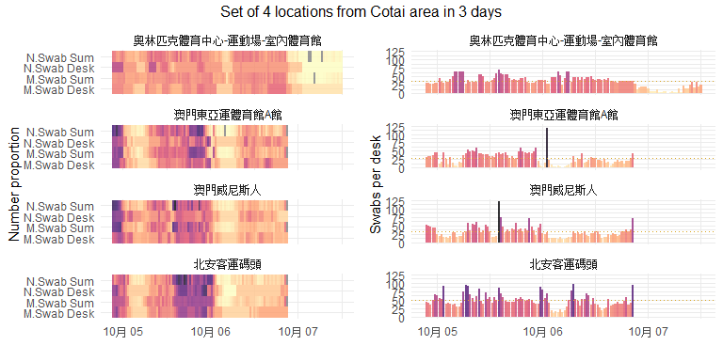

Slide 27
Map
An animation for the 4th quartile swab per desk to each location within 48 hours
Bubble size representing swab per desk
Reflecting well the peak time by the 10th / 16th hour (Oct-06 7am / 1pm)
The 31st -36th hour crowd appears only in Macau peninsula (Oct-07 4am - 9am)
A notable crowd appears right by the 47th hour (Oct-07 8pm)
By Venetian Cotai Arena, 2nd day is less stressed comparing to the 1st day

Slide 28
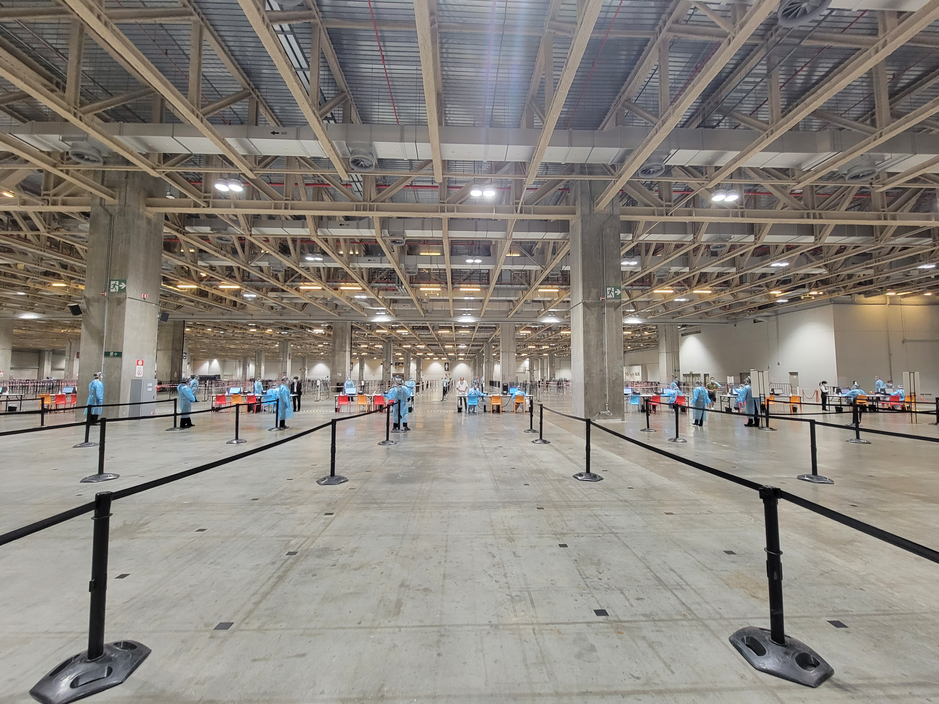
Venetian-image-tag

Slide 29
There are about 20 swab desks, by 2nd day noon only 5-6 is operating and there is nearly no waiting queue

Slide 30
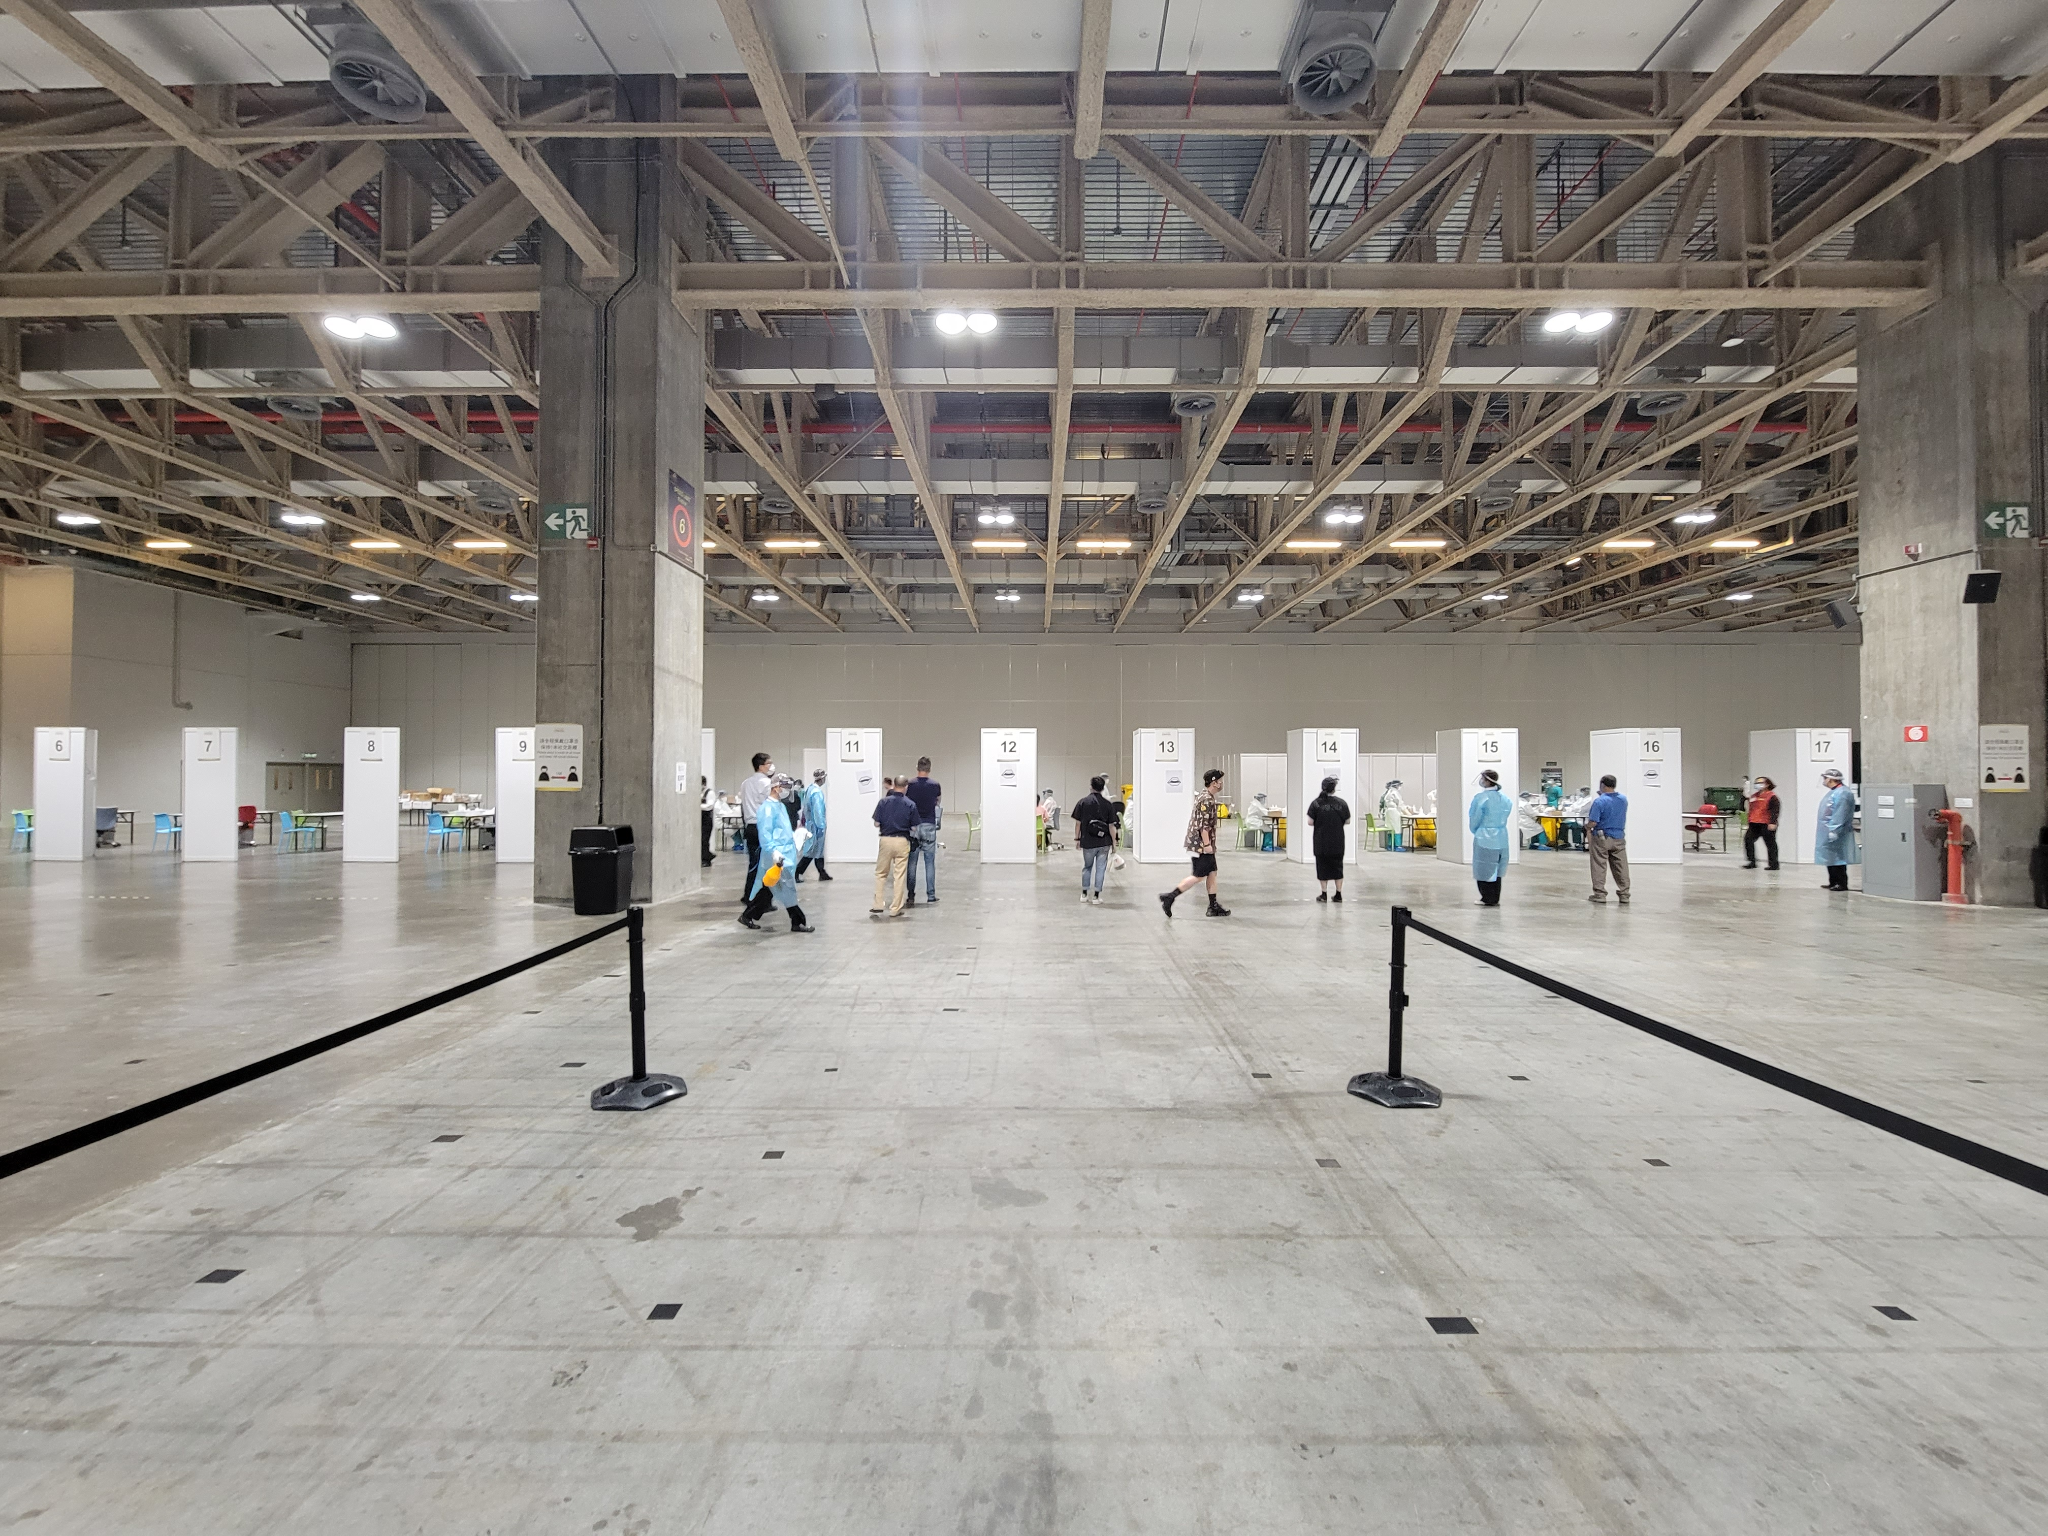
Venetian-image2-tag

Slide 31
Summary
We can use Swab per desk by every 30 minutes as a measure to review the load balance to each station, ideally this number is under 33
Potential improvement can be made, if we can increase the swab desks in station during peak rush hours
Relocating more / less staff depending on the next hour booking numbers
Limit for number of bookings for an upcoming time in case if shortage, also avoid relocation of staffs

Slide 32
Reference
8個常規核酸檢測站在全民核酸檢測結束後將重新開放並延長服務時間 今(4)日晚上9時至10月7日晚上9時進行第三次全民核酸檢測 第 3 次較第 2 次全民核檢首 3 小時採樣人數多 各個採樣站點的輪候情況理想

Slide 33

qr-tag

